Slide 1

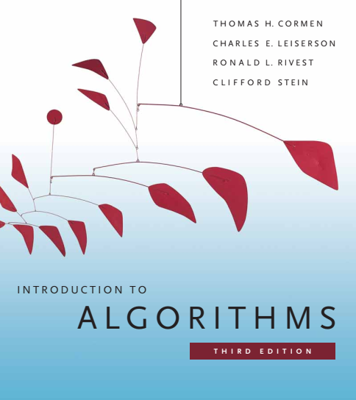
Design and Analysis of Algorithms
Dr. Sajid Iqbal
Reference Book
Introduction to Algorithms 3rd Edition By Thomas H. Cormen et. al.
https://mitpress.mit.edu/books/introduction-algorithms-third-edition
COMEDXD

Slide 2
Introduction
The algorithms

Slide 3
What is algorithm
An algorithm is any well-defined computational procedure that takes
Some value/s as input
Performs some processing
Produces some value/s as output.
An algorithm can be considered as a hypothetical machine as shown in figure
Algorithms can also be defined as
An algorithm is thus a sequence of computational steps that transform the input into the output.
We can also view an algorithm as a tool for solving a well-specified computational problem.
Input
Processing
output
A way of doing something

Slide 4
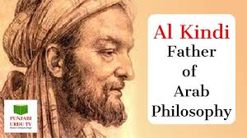
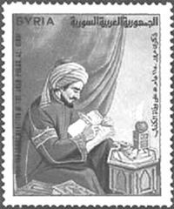
History of Algorithm
Algorithm is process to solve a problem
The concept of algorithm has existed since ancient times.
Arithmetic algorithms, such as a division algorithm, was used by ancient Babylonian mathematicians c. 2500 BC and Egyptian mathematicians 1550 BC.
Greek mathematicians used algorithms in the
Finding prime numbers
Finding the Euclidean algorithm for finding the greatest common divisor of two numbers.
Arabic mathematicians such as Al-Kindi in the 9th century used cryptographic algorithms for code-breaking, based on frequency analysis.

Slide 5
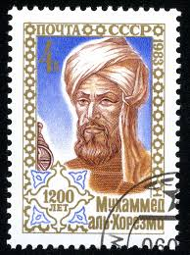
The Algorithm
The word algorithm is derived from the 9th century Persian mathematician Muḥammad ibn Mūsā al-Khwārizmī, Latinized Algoritmi.
A partial formalization of algorithm began with attempts to solve the Entscheidungs problem (decision problem) posed by David Hilbert in 1928.
Later formalizations were framed as attempts to define "effective calculability" or "effective method".
Those formalizations included the
Gödel–Herbrand–Kleene recursive functions of 1930, 1934 and 1935,
Alonzo Church's lambda calculus of 1936,
Emil Post's Formulation 1 of 1936,
Alan Turing's Turing machines of 1936–37 and 1939.

Slide 6
Muḥammad ibn Mūsā al-Khwārizmī (780 – 850) محمد بن موسى الخوارزميّ المجوسـيّ القطربّـليّ
Contributions
Algebra
Arithmetic
Astronomy
Trigonometry
Geography
Jewish calendar
Other works
He worked in Baghdad as a scholar at the House of Wisdom established by Caliph al-Ma’mūn, where he studied the sciences and mathematics, which included the translation of Greek and Sanskrit scientific manuscripts.
He was the native of Khwarazm', a region that was part of Greater Iran and is now in Uzbekistan.^{[19][20]}

Slide 7
Algorithm Development
Problem definition
Development of a model
Specification of the algorithm
Designing an algorithm
Checking the correctness of the algorithm
Analysis of algorithm
Implementation of algorithm
Program testing
Documentation preparation
Problem definition
Algorithm LargestNumber
Input: A list of numbers L.
Output: The largest number in the list L.
Solution
if L.size = 0 return null
largest ← L[0]
for each item in L, do
if item > largest, then
largest ← item
return largest

Slide 8
Properties of an Algorithm
Input: An algorithm must receive some input
Output: At least one quantity is produced by the algorithm At least one quantity is produced.
Definiteness: Each step in an algorithm must be very clear in its operation
Finiteness: All the steps must be completed/terminated in finite amount of time
Effectiveness: Every instruction must be effective and can be carried out manually
Correctness: The algorithm should perform the task for which it is designed
Feasibility − Should be feasible with the available resources.

Slide 9
Why Algorithm
There may be multiple ways to solve a problem
Finding best, fast and most accurate method to solve a problem is the requirement for a computer scientist
So that she/he can build a faster, better and efficient software
What kind of problems can be solved through algorithms
Virtually all kinds of computational problems can be solved
Few other examples are listed below
search algorithms,
sorting algorithms,
merge algorithms,
numerical algorithms,
graph algorithms,
string algorithms,
computational geometric algorithms,
combinatorial algorithms,
medical algorithms,
machine learning,
cryptography,
data compression algorithms and parsing techniques.

Slide 10
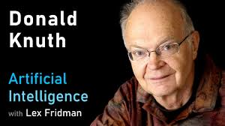
Algorithmic analysis
The term is coined by Donald Knuth
It is the process of finding the computational complexity of algorithms
the amount of time, storage, or other resources needed to execute them.
This involves determining a function that relates the length of an algorithm's input to the number of steps it takes (its time complexity)
The number of storage locations it uses (its space complexity).
An algorithm is said to be efficient when this function's values are small, or grow slowly compared to a growth in the size of the input.
Different inputs of the same length may cause the algorithm to have different behavior, so best, worst and average case .
Worst Case: The function describing the performance of an algorithm is usually an upper bound

Slide 11
Asymptotic Notations
“ to estimate the complexity function for arbitrarily large input”
For this Big O notation, Big-omega notation and Big-theta notation
Asymptotic estimates are used because different implementations
of the same algorithm may differ in efficiency.
Efficiencies of any two "reasonable" implementations of a given algorithm are related by a constant multiplicative factor called a hidden constant.
Exact measures of efficiency can be computed but they usually require certain assumptions concerning the particular implementation of the algorithm, called model of computation

Slide 12
Cost models
Time efficiency estimates depend on what we define to be a step.
For the analysis to correspond usefully
to the actual execution time, the time required to perform a step must be guaranteed to be bounded above by a constant.
One must be careful here; for instance, some analyses count an addition of two numbers as one step and some do not.
Two cost models are generally used
Uniform cost model or uniform-cost measurement assigns a constant cost to every machine operation, regardless of the size of the numbers involved
Logarithmic cost model or logarithmic-cost measurement, assigns a cost to every machine operation proportional to the number of bits involved

Slide 13
Runtime Analysis
It is a theoretical classification that estimates and anticipates the increase in running time of an algorithm as its input size (denoted as n) increases.
Algorithms are platform independent hence it is difficult to compare two different implementations of same algorithm
Hence we only analyze in context of input size
Let a search algorithm is implemented on two computers
A: A new sate of the art computer – linear search
B: A ten years old computer – binary search
N List size | Computer A run-time (in nanoseconds) | Computer B run-time (in nanoseconds)
16 | 8 | 100,000
63 | 32 | 150,000
250 | 125 | 200,000
1,000 | 500 | 250,000

Slide 14
Algorithm Growth Rate
n (list size) | Computer A run-time (in nanoseconds) | Computer B run-time (in nanoseconds)
16 | 8 | 100,000
63 | 32 | 150,000
250 | 125 | 200,000
1,000 | 500 | 250,000
... | ... | ...
1,000,000 | 500,000 | 500,000
4,000,000 | 2,000,000 | 550,000
16,000,000 | 8,000,000 | 600,000
... | ... | ...
63,072 × 10¹² | 31,536 × 10¹² ns, or 1 year | 1,375,000 ns, or 1.375 milliseconds
Quadrupling the input size only increases the run time of Computer B by a constant amount

Slide 15

Order of Growth
As the input size increases, the running time of algorithm increases
The rate of growth of algorithm running time can be expressed by a mathematical function $f(n)$
If the $f(n)$is multiplied with some constant, it can give the upper bound of function growth.

Slide 16

Empirical order of growth
Let we measure growth rate as $gr=rt_{i}/rt_{i−1}$
n (list size) | Computer A Growth rate | Computer A run-time | Computer B Growth rate | Computer B run-time
16 |  | 8 |  | 100,000
63 | 32/8=4 | 32 | 1.5 | 150,000
250 | 125/32=3.9 | 125 | 1.3 | 200,000
1,000 | 4 | 500 | 0.8 | 250,000
... |  | ... |  | ...
1,000,000 |  | 500,000 | - | 500,000
4,000,000 | 4 | 2,000,000 | 0.9 | 550,000
16,000,000 | 4 | 8,000,000 | 0.91 | 600,000
... |  | ... |  | ...
63,072 × 10¹² |  | 31,536 × 10¹² ns, or 1 year |  | 1,375,000 ns, or 1.375 milliseconds

Slide 17

Evaluating run-time complexity
The run-time complexity for the worst-case scenario of a given algorithm can be evaluated by examining the structure of the algorithm and making some simplifying assumptions
Each instruction is executed in discrete time
Although each computer will give a different time
We suppose $T_{1},T_{2},T_{3},T_{4},T_{5},T_{6},T_{7}$ as time of each step
Outer loop will execute n+1 times
Inner loop will execute $1,2,…n$times in total. $\frac{n\left(n+1\right)}{2}$
Step 5 will be executed $\frac{n\left(n+1\right)}{2}$times
Step 6 has cost T6 and will be executed $\frac{n\left(n+1\right)}{2}$times
Total time for step 6 is $T6∗\left(\frac{n\left(n+1\right)}{2}\right)$
get a positive integer n from input
if n > 10
print "This might take a while..."
for i = 1 to n
for j = 1 to i
print i * j
print "Done!"

Slide 18


Total time calculation of an algorithm
Step 1 time: $T_{1}$
Step 2 time: $T_{2}$
Step 3 time: $T_{3}$
Step 4 time: $T_{4}∗(n+1)$
Step 5 time: $T_{5}∗\frac{n∗\left(n+1\right)}{2}$
Step 6 time: $T_{6}∗\frac{n∗\left(n+1\right)}{2}$
Step 7 times: $T_{7}$
Total time = $f(n)$
$f\left(n\right)= T_{1}+ T_{2}+T_{3}+T_{4}∗\left(n+1\right)+T_{5}∗\frac{n∗\left(n+1\right)}{2}+T_{6}∗\frac{n∗\left(n+1\right)}{2}+T_{7}$
${f\left(n\right)=T}_{1}+ T_{2}+T_{3}+nT_{4}+T_{4}+\frac{n^{2}T_{5}}{2}+\frac{nT_{5}}{2}+\frac{{n^{2}T}_{6}}{2}+\frac{nT_{6}}{2}+T_{7}$
$f\left(n\right)=n^{2}\left(\frac{T_{5}}{2}+\frac{T_{6}}{2}\right)+n\left(T_{4}+T_{5}+T_{6}\right)+(T_{1}+ T_{2}+T_{3}+T_{7})$
${f\left(n\right)=n}^{2}C_{1}+nC_{2}+C_{3}$
get a positive integer n from input
if n > 10
print "This might take a while..."
for i = 1 to n
for j = 1 to i
print i * j
print "Done!"

Slide 19
Classification
There are various ways to classify algorithms, each with its own merits.
By Implementation | By design paradigm | Optimization problems | By field of study | By complexity
Recursion | Brute-force | Linear programming | search algos, sorting algos merge algos numerical algos graph algos, string algos, computational geometric algos, combinatorial algos, medical algo, machine learning, cryptography, data compression algos parsing techniques. | Constant time
Logical | Divide and conquer | Dynamic programming |  | Logarithmic time
Serial, Prallel, Distributed | Search and enumeration - graphs | The greedy method |  | Linear time
Deterministic Non-deterministic | Randomized algorithm | The heuristic method |  | Polynomial time
Exact or Approximate | Reduction of complexity |  |  | Exponential time
Quantum | Back tracking
https://en.wikipedia.org/wiki/Algorithm

Slide 20
What you need to learn algorithms
Computer Programming
Mathematics
Attitude
Data Structures
Statistics
Lot of reading
Parallel Programming

Slide 21
Thanks for watching
Dr. Sajid Iqbal
Assistant Professor
Department of Computer Science
Bahauddin Zakariya University, Multan
Allah Hafiz

